Slide 1

Support Vector Machines
Simply Explained

Slide 2
Steps in a SVM algorithm
Finding optimal hyperplane
Hyperparameter Tuning
Choosing a Kernel

Slide 3
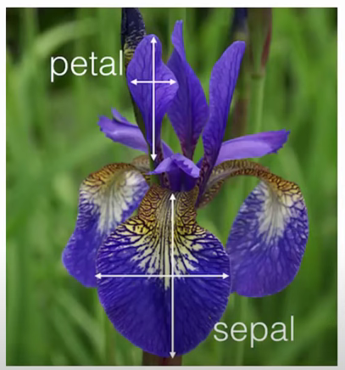
Let’s say our dataset is iris dataset
Finding the optimal hyperplane
(this dataset is inside sklearn library)

Slide 4
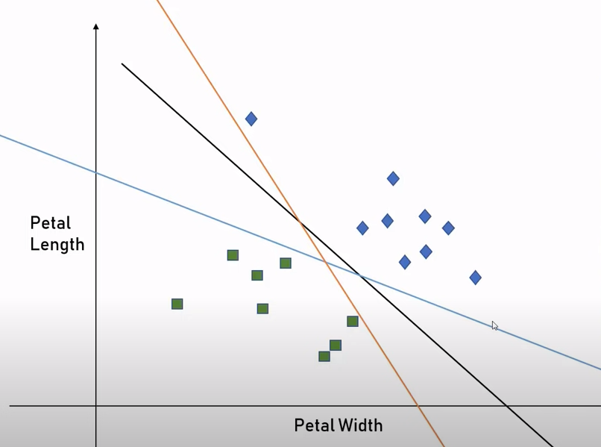

For our dataset of two species, we can have any of these three lines as a valid classifier line(decision boundary) between the two classes
Finding the optimal hyperplane

Slide 5
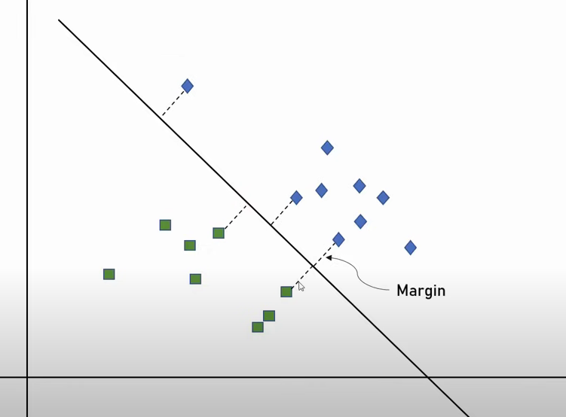
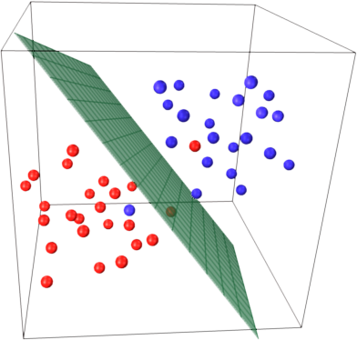
Finding the optimal hyperplane
The margin is defined as the distance between the hyperplane and the nearest data point from either class.
Hyperplane (classifier line in 2D, or hyperplane in higher dimensions) is the one that best separates the data points of different classes

Slide 6
Choosing a Kernel
Kernel are the mathematical functions used to transform the input features into a higher-dimensional space. The choice of the kernel depends on the characteristics of the decision boundary.
Common kernels include linear, polynomial, radial basis function (RBF), and sigmoid.

Slide 7
Hyperparameter Tuning
C (Cost parameter): C is the regularization parameter that controls the trade-off between having a smooth decision boundary and classifying the training points correctly
Gamma: This parameter is specific to the RBF kernel and controls the width of the Gaussian distribution. A small gamma results in a wider bell-shaped curve, leading to a smoother decision boundary, while a large gamma results in a narrower curve, making the decision boundary more complex
Degree: This parameter is specific to the polynomial kernel and defines the degree of the polynomial function. Higher degrees can capture more complex relationships but may also lead to overfitting

Slide 8

How do we find the Best Kernel and Hyperparameters
Always remember that the choice of the kernel and hyperparameters is problem-dependent, and there is no one-size-fits-all solution. It often involves a combination of empirical testing, domain knowledge, and careful consideration of the characteristics of the data. Regularly evaluate the model's performance on validation sets to ensure that the chosen kernel generalizes well to unseen data

Slide 9

Let’s jump to some hands-on to understand it completely

